Slide 1
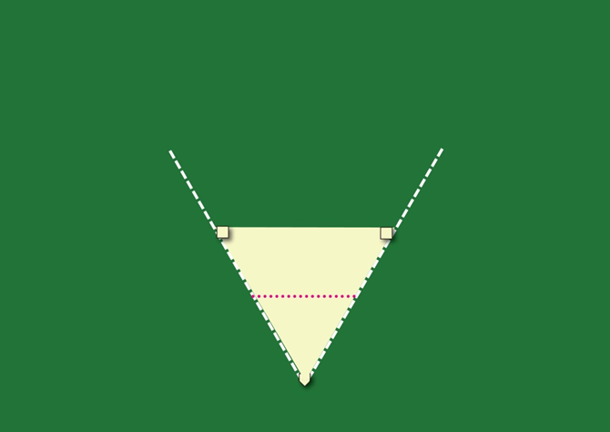
BEEBALL
ROOKIE LEAGUE

Slide 2
TRIANGLE of 60°
2 BASES
1 HOMEPLATE

Slide 3
◄ BACKSTOP or WALL ►
2nd BASE ►
◄ 1st BASE
TRIANGLE of 60°
2 BASES
1 HOMEPLATE
◄ HOMEPLATE

Slide 4
◄ BACKSTOP or WALL ►
◄ 15 METERS ►
◄ 15 METERS ►
◄ 15 METERS ►

Slide 5
◄ BACKSTOP or WALL ►
◄ 15 METERS ►
◄ 15 METERS ►
◄ 15 METERS ►
◄ 5 METERS ♠

Slide 6
◄ BACKSTOP or WALL ►
CONES ►
◄CONES
◄ DEFENSE LINE ►
◄ TIP LINE ►
CONES ►
◄CONES

Slide 7
◄ BACKSTOP or WALL ►
CONES ►
◄CONES
◄ DEFENSE LINE ►
◄ 10 METER ►
◄ 10 METER ►
◄ TIP LINE ►
CONES ►
◄CONES
◄ PLAYERS BENCH►
◄ PLAYERS BENCH►

Slide 8
OUTFIELD
DEFENSE LINE
INFIELD
◄ FAUL AREA►
◄ FAUL AREA►
◄ TIP LINE ►
FAUL
AREA
BATTING TEE

Slide 9
DEFENSE TEAM FIELDERS
DEFENSE LINE
◄COACH
◄ TIP LINE ►
POSITIONS
DEFENSE TEAM
◄CATCHER

Slide 10
◄COACH
START OF
THE GAME
BATTER 1►
COACH BLUE ►

Slide 11
◄COACH
◄BATTER 1
START OF
THE GAME
BATTER 2►
COACH BLUE ►

Slide 12
BATTER 1►
◄COACH
◄BATTER 2
START OF
THE GAME
BATTER 3►
COACH BLUE ►

Slide 13
COMPLETE RULES OF BEEBALL ON OUR WEBSITES
www.europeansoftball.org/ OR www.baseballeurope.com/

Slide 14
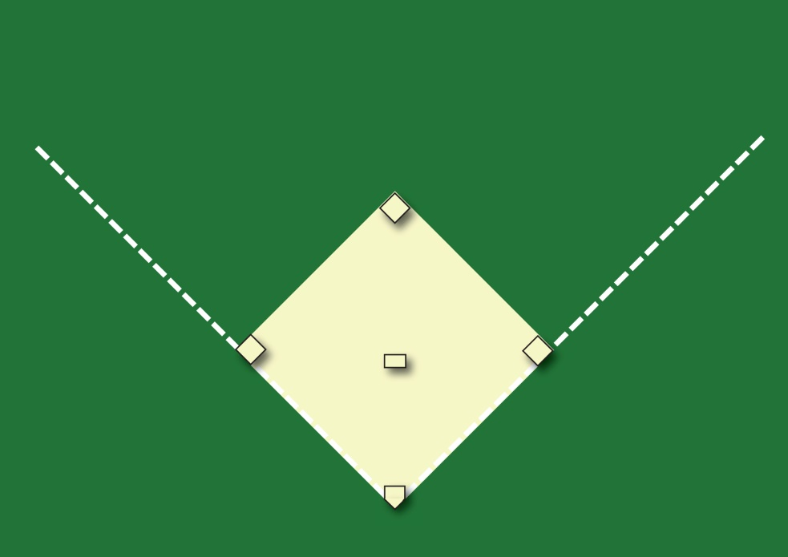
BEEBALL
MAJOR LEAGUE

Slide 15
◄ BACKSTOP or WALL ►
VARIABEL BACK or FRONT
SQUARE FIELD
3 BASES + PITCHERPLATE
1 HOMEPLATE
◄ 18.3 METERS ►

Slide 16
POSITIONS
DEFENSE TEAM RED
◄COACH
◄COACH
3 x COACH TOSS LONG
1 X COACH TOSS SHORT
REST BATTING TEE

Slide 17
MANUALS FOR COACHES OF BEEBALL ON OUR WEBSITES
www.europeansoftball.org/ OR www.baseballeurope.com/

